Slide 1
Off - The - Grid
The Team:
Ian Schneier Linda Palacios
Weikang Zhang Xucheng You
Jingwen Luo Alec Motazedi
Sponsored By:
Prof. Alan Mickelson
Notes:
Team ->off the grid

Slide 2

Labor and Responsibility
Name: Alec Motazedi
Position: Finance and Documents Manager
Specialty: RF and Instrumentation
Name: Ian Schneier
Position: Co-Lead
Specialty: Hardware/Embedded Systems

Slide 3


Labor and Responsibility
Name: Linda Palacios
Position: Communications Manager
Specialty: Embedded and Software/Application
Name: Xucheng You
Position: Co-Lead
Specialty: Power Electronics

Slide 4


Labor and Responsibility
Name: Weikang Zhang
Position: Signal Processing
Specialty: Power/Communications
Name: Regina Luo
Position: Codebase Manager
Specialty: Software/Applications

Slide 5
Division of Labor
Hardware | Communication | Software | Housing
Weikang Ian Xucheng | Weikang Ian Alec | Regina Linda Alec | Regina Linda Xucheng

Slide 6
Objective and Purpose

Slide 7
Objective
Create a device to provide a Wi-Fi network during the aftermath of major disasters.

Slide 8
Purpose
To provide rescue teams and victims a means of communication through a reliable emergency network
Notes:
Provide a network to assist rescue operation and provide communication to civilians in disaster areas

Slide 9

What:
An emergency network - Gridless Wireless Network (G.W.N.)
Easily and quickly deployed in the 72 hour period after disaster strikes
Maneuverable, shock-resistant, and waterproof
Notes:
So what we propose is a signal transmitting device, it will be portable, rugged, and create a wireless network.
TO elaborate, our device will transmit a wireless internet network open to any device that can have an internet connection.
It will be designed with portability in mind, for easy transportation and deployment in the area affected by the disaster.
Finally, it will be housed in a packaging with a rugged design that will be water tight, drop resistant, and be able to withstand any other hazards present in the deployment area.

Slide 10

Why:
Victims may need immediate attention
Resources may be depleted or depleting
Damage caused by disasters take weeks to correct
Rescue rate increases when rescue teams know location of victims
No available solution to grid failure

Slide 11
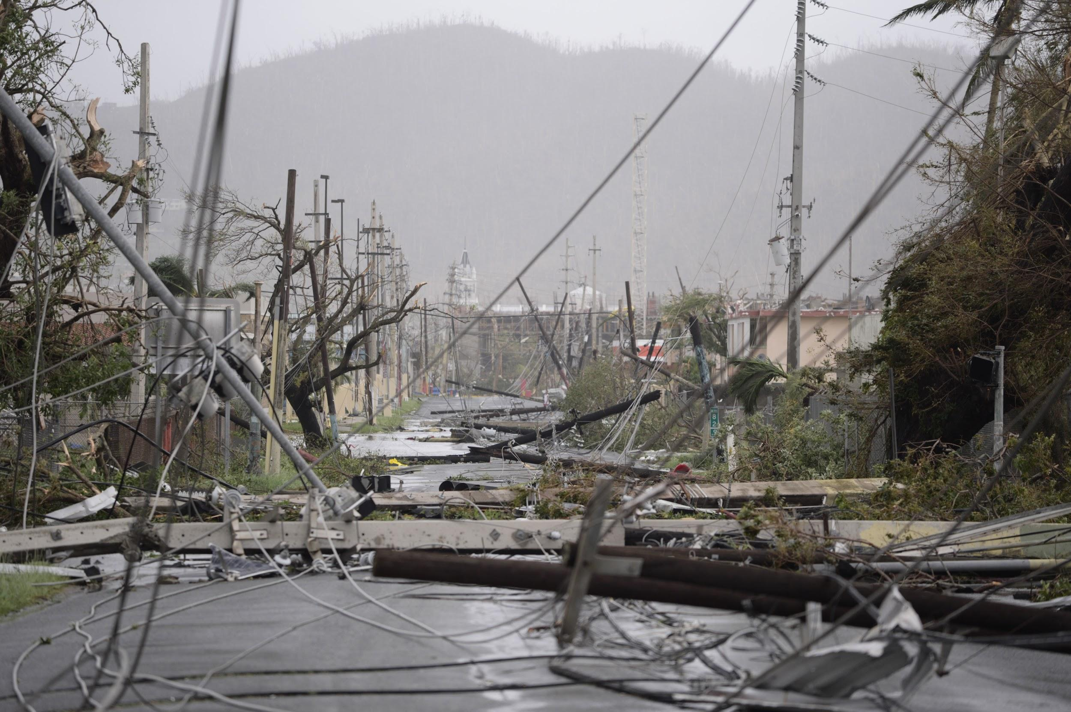

Slide 12
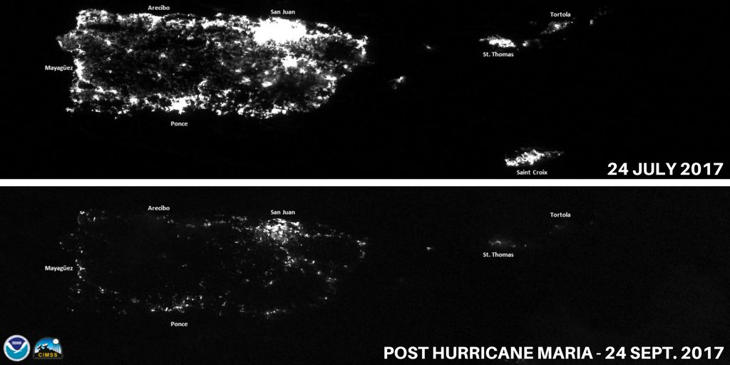

Slide 13

How:
Pair with cell phones and other devices to extend coverage
Multinode, breadcrumb network
Multi antenna system
Monodirectional - long range
Omnidirectional - close range

Slide 14
System Overview

Slide 15
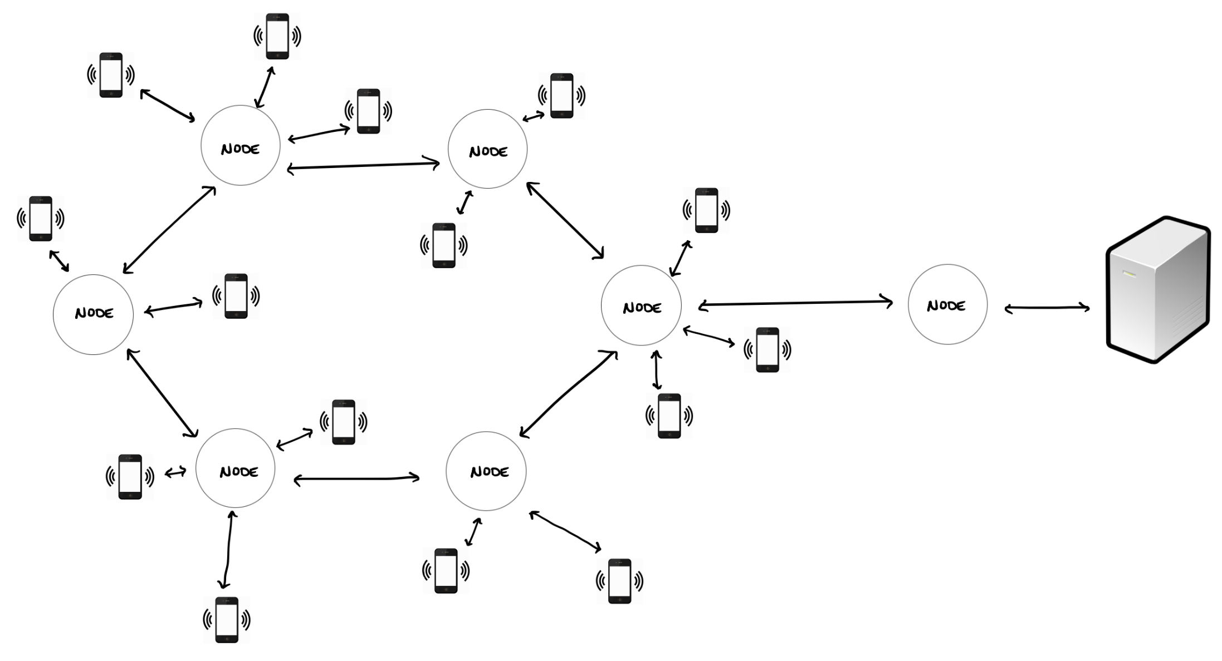

Slide 16

Design Levels
Level 0:
Single module block diagram with critical inputs and outputs identified
Level 1:
The organization and interconnection between modules
The functional requirements for each module at this level
Level 2:
A more indepth logical subsystem of systems in level 1

Slide 17
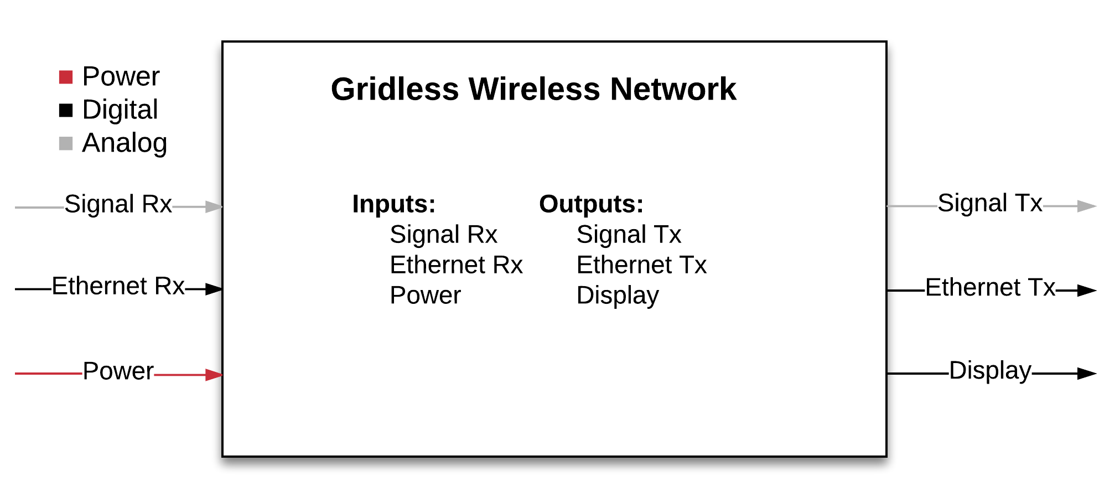
Level 0

Slide 18
Level 0
Inputs | Signal Rx, Ethernet Rx, and Power
Outputs | Signal Tx, Ethernet Tx, and Display
Description | Restores communications in areas without access to Internet by applying Wireless Mesh Network concepts

Slide 19
Level 1
Notes:
Input transmit signal, how communication will works
Communication will deal with RX signal and Tx , wifi will become tx signa

Slide 20
Level 1
Module | Communications
Inputs | Rx signal, data from MCU
Outputs | Tx signal
Description | Receive and transmit data via Wi-Fi
Module | Power System
Inputs | Power
Outputs | Multiple Voltage Levels, Battery Status
Description | Provide power to components

Slide 21
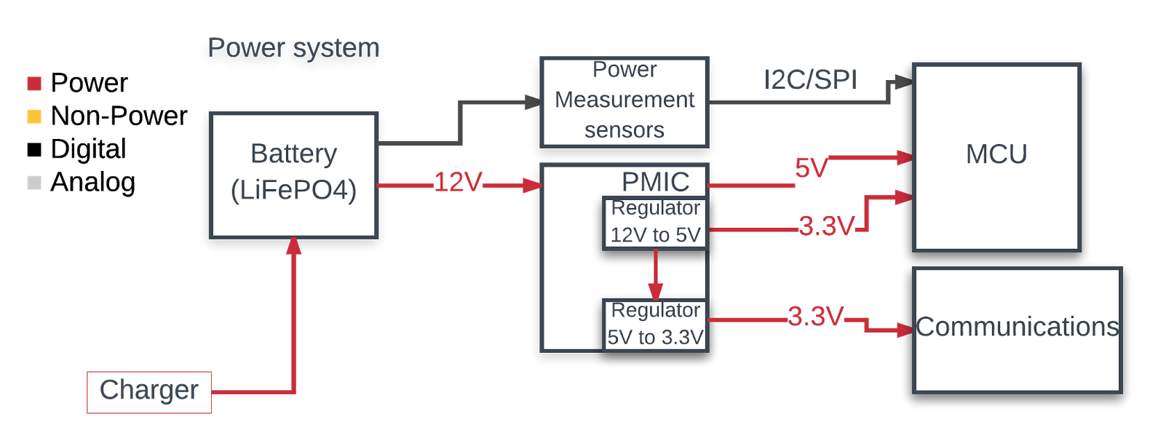
Level 2
Notes:
Big battery capacity for long operating time with built in LED indicator, power measurement sensors to measure status, DC-DC converters(regulators) in PMIC,

Slide 22
Level 2
Component | Power Management Integrated Circuit (PMIC)
Inputs | 12V from battery
Outputs | 5V, 3.3V to MCU and Communication Units
Description | Use regulators to supply multiple stages of voltage (5V, 3.3V) to other units.
Component | Power measurement sensors
Inputs | Battery output power
Outputs | Digital data of battery status
Description | Measures battery status (output power) and sends it to MCU to analyze power consumption.

Slide 23
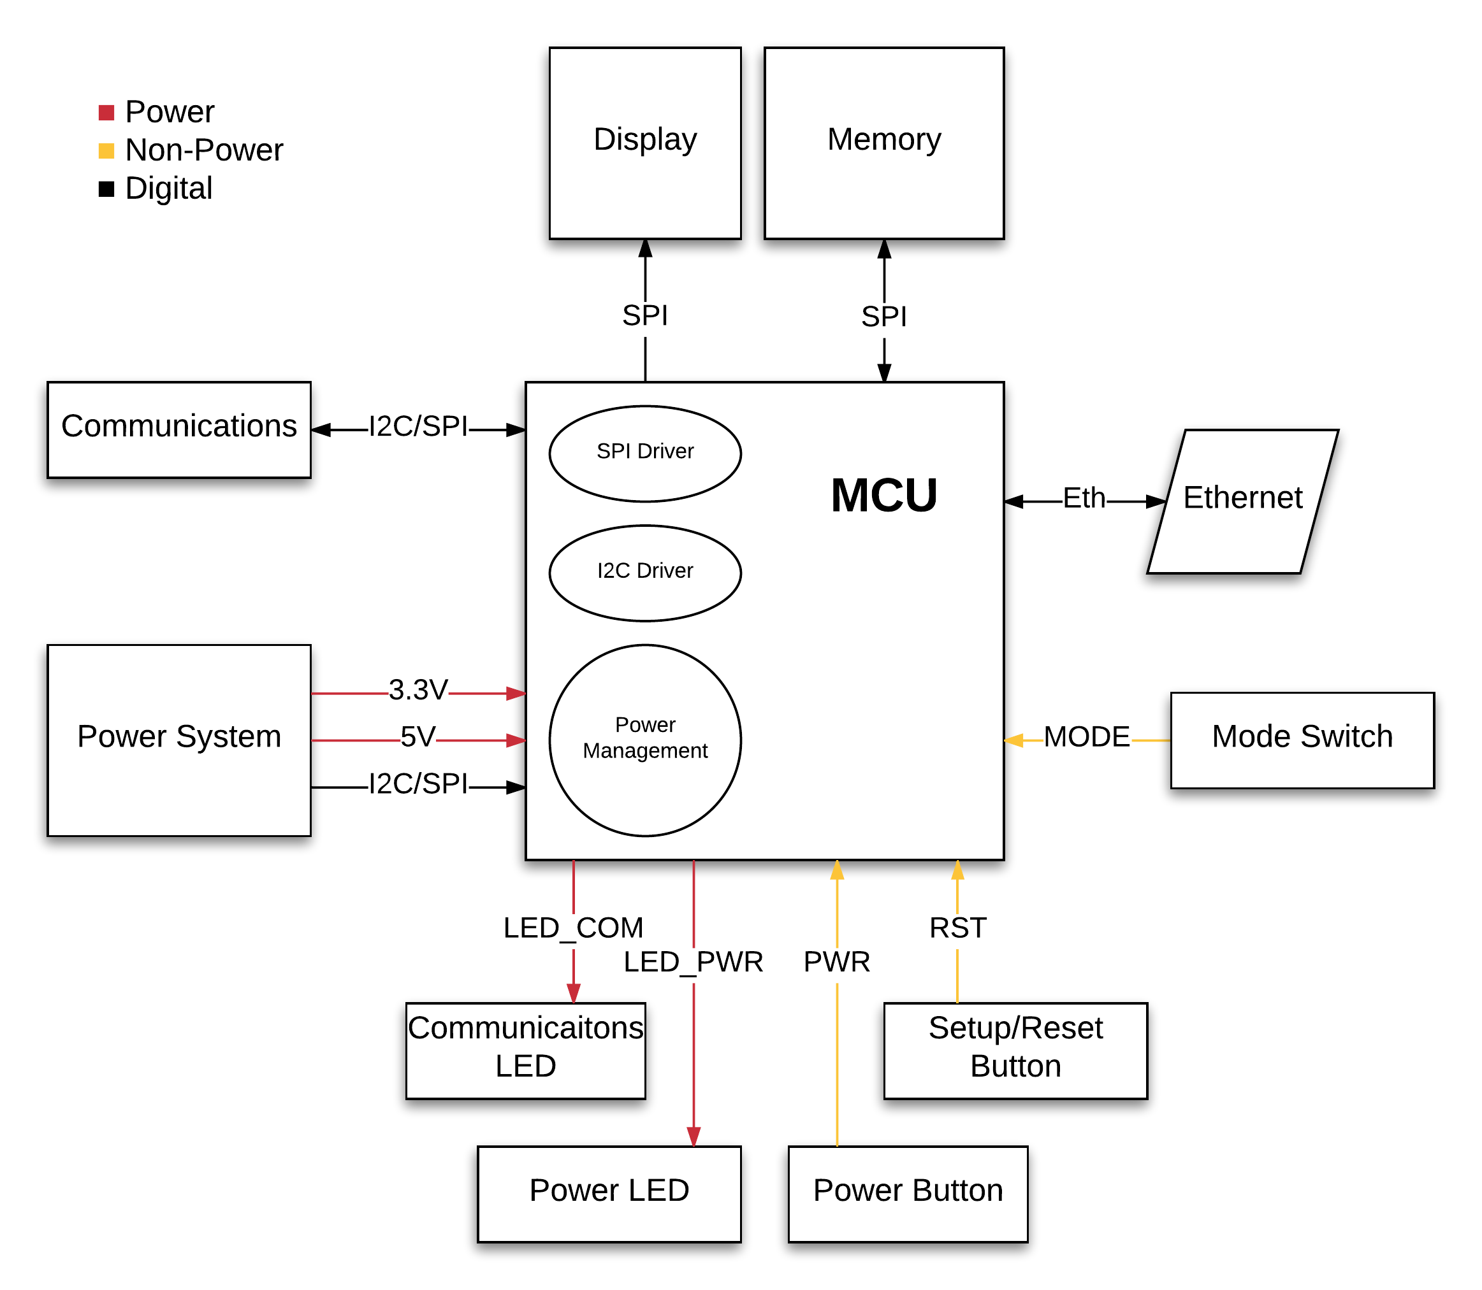
Level 2
Notes:
MCU - microcontroller control unit

Slide 24
Level 2
Component | MCU
Inputs | Power Button, Setup/Reset Button, SPI to Communications, power system I2C/SPI data connection, 5V and 3.3V power, Memory
Outputs | Power LED, Communications LED, 2x Ethernet Ports, Memory
Description | The component responsible for facilitating data transmission via the transceiver and ethernet connections. Stores information on the Memory unit.

Slide 25

Critical Components
Battery (determining dimension of the product)
Antenna (determining the communication range and power consumption)
Microcontroller (802.11ac protocol plus enough Tx power)
Transceiver (Matching amplifier and modulation inside)
Software (Searching and Connecting)
Waterproof Case

Slide 26
Hardware Overview
Rechargeable battery
Transceiver and Antenna
Ethernet port x2
Battery monitor (PMU)
Updates user on approximate life remaining
Single PCB
Microcontroller Unit (including antenna driver circuit) + Power Management Unit

Slide 27
Hardware Requirements
Microcontroller must be able to handle multiple node connections
System must have a life-span of 72+ hours at 1W
Antenna and transceiver must be able to transmit at 30dBm to cover enough range

Slide 28

Communication Overview
Utilizing wireless technology and frequencies
ISM bands 2.4GHz and 5.8GHz
Three on board antennas
1 Omnidirectional - short range (1 km)
2 Monodirectional - long range (5 km)
Transmit signals via G.W.N. nodes

Slide 29
Communication Requirements
Must provide WLAN in areas experiencing emergency situations
Good gain coverage over 1 km (omnidirectional) and 5 km (monodirectional)
Low power/high efficiency - maximize battery life
Antennas must be small enough for the circuit board
Must have good coverage with interference and reflection

Slide 30
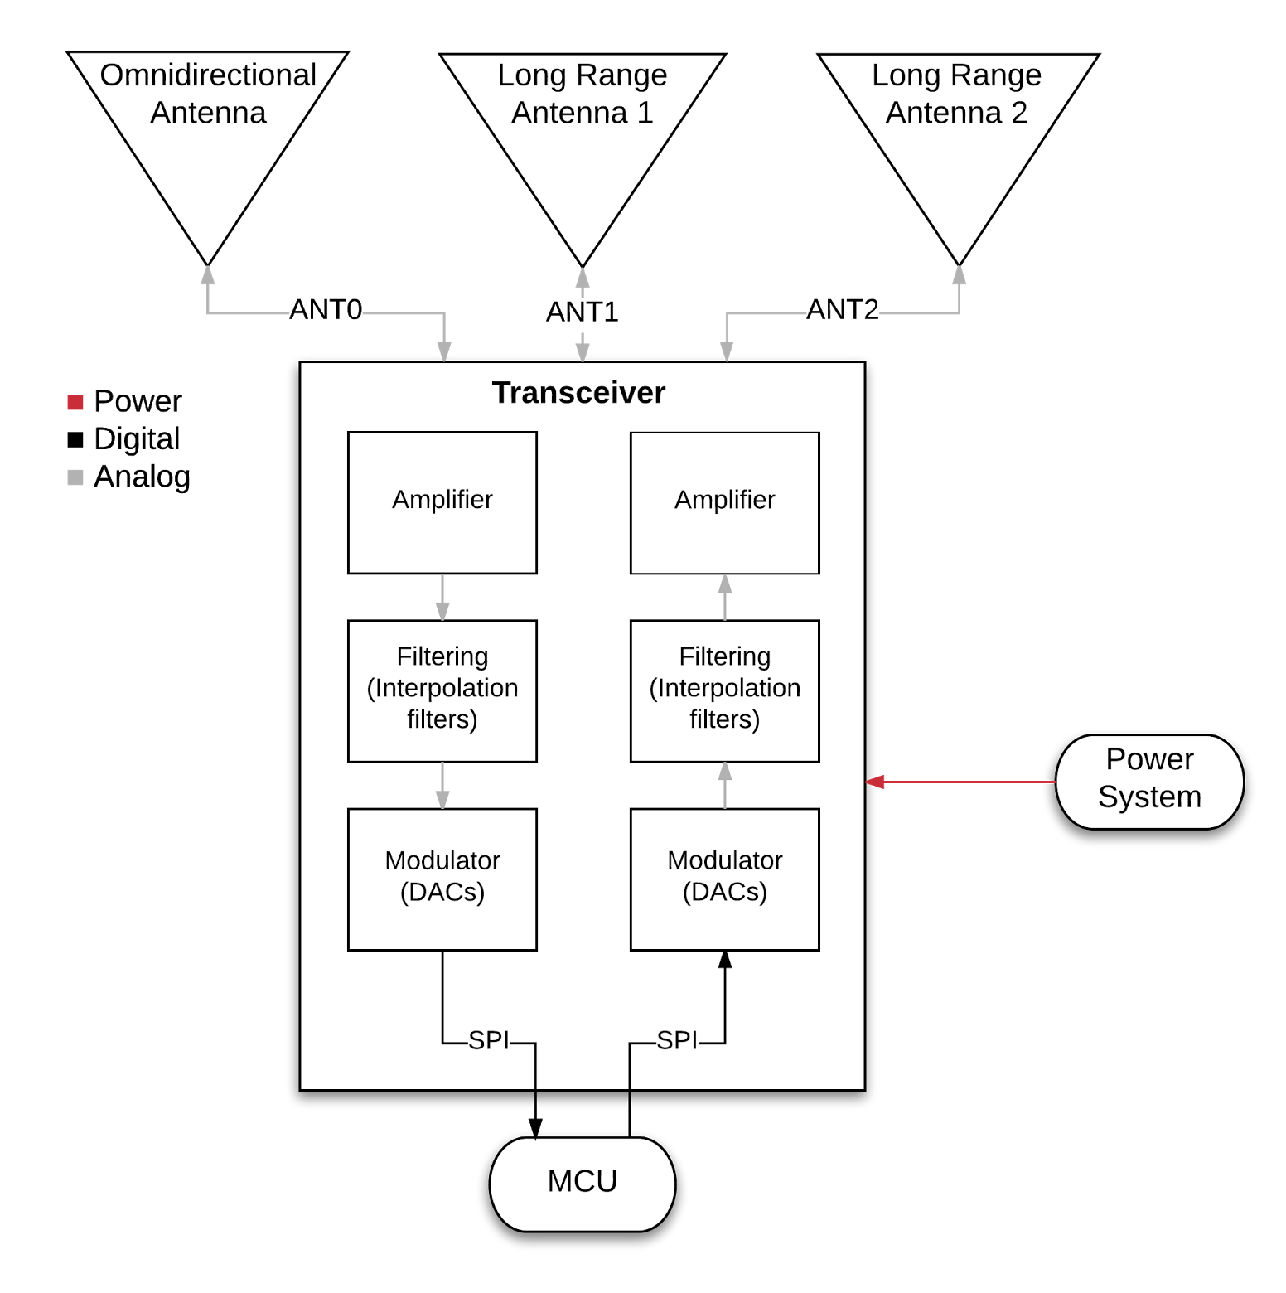
Component | Transceiver
Inputs | Electricity from Power System, SPI from MCU, ANT0, ANT1, ANT2
Outputs | SPI from MCU, ANT0, ANT1, ANT2
Description | Transmit modulated signal and receive analog signals.
Component | Long Range Antenna (x2)
Inputs | ANT1, ANT2
Outputs | ANT1 or ANT2 (same as input)
Description | Transmit data via 2.4GHz signal.
Component | Omnidirectional Antenna
Inputs | ANT0
Outputs | ANT0
Description | Generate wireless network with 1km coverage area.

Slide 31

Software Overview
Maintain Wireless network
Employ a geolocation service
Have ability to switch between two board antennas
Mini-chat Program

Slide 32

Software Requirements
Must transmit signal between nodes
long range antenna (5km) scans periodically
short range (1km ~ 2km) emits constantly
Send safe shelter location to each device
Be able to prioritize urgent data vs non-urgent data
Keywords, battery life, etc.
Notes:
Multiple data

Slide 33

Housing Overview
Shock absorbent housing protects hardware
Mobile enough to be carried and distributed by rescue workers
May be dropped from heights

Slide 34
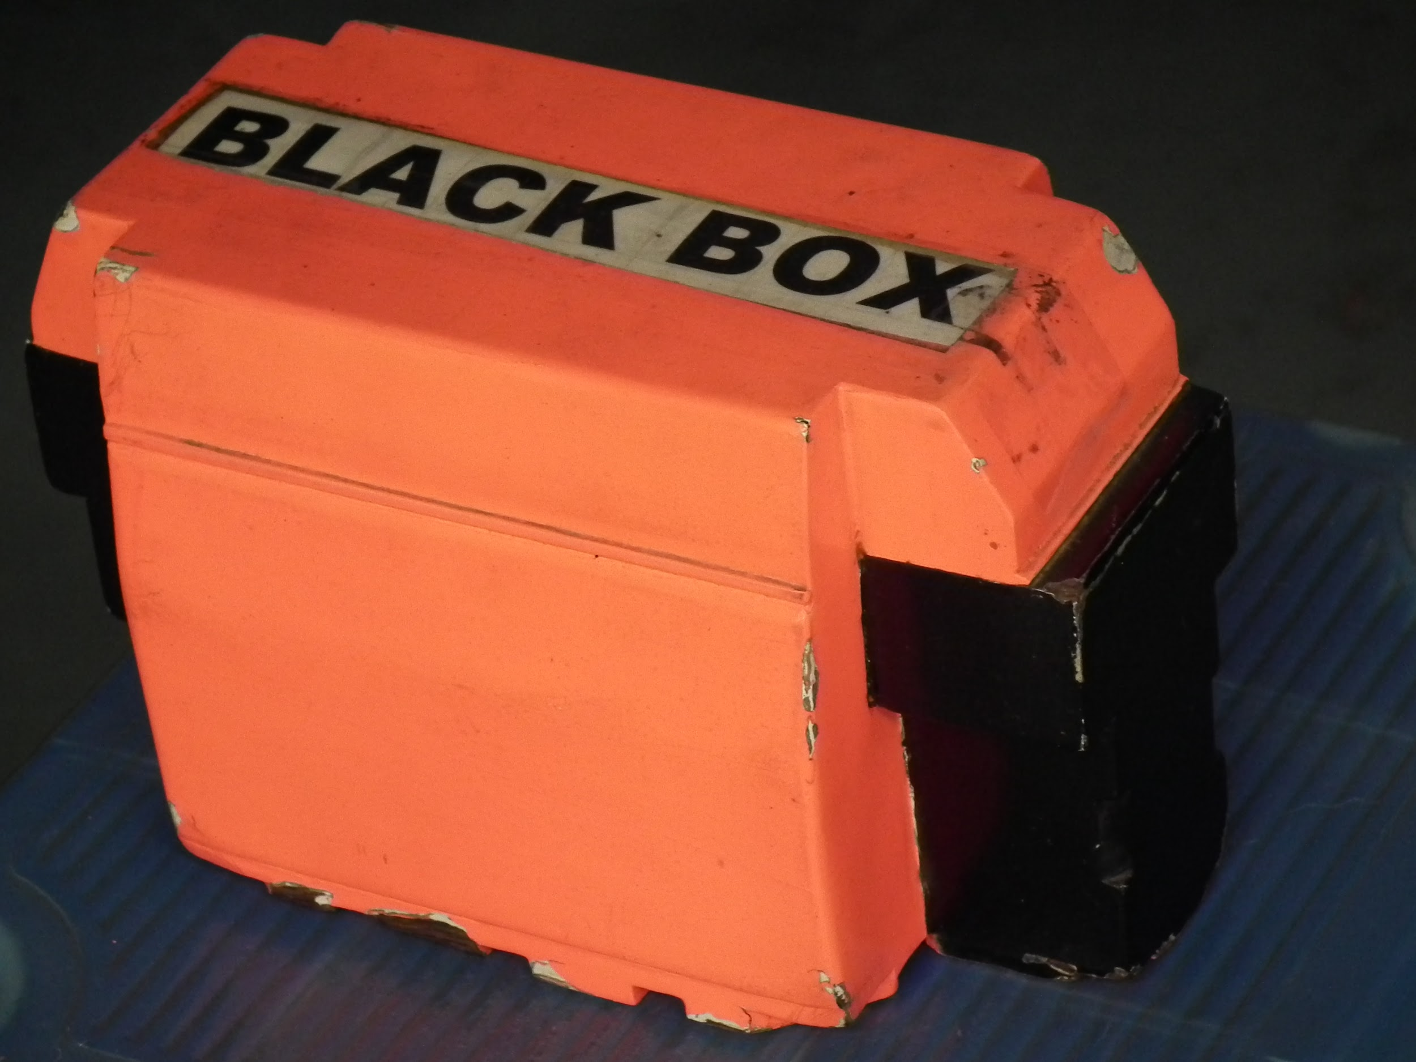
Housing Requirements
Must withstand 15 ft (5 m) drop
Must be hermetically sealed (waterproof)
Accessible ethernet port for charging and I/O
Must weigh under 10 lbs
Noticeable and vibrant pattern or color
Notes:
Battery is 6.7 lbs itself.

Slide 35
Social Impact

Slide 36

Who Benefits?
Rescue workers
Able to geolocate victims using G.W.N.
Increases the success rate of rescuing victims
Civilians
Able to communicate with others in the area - shared resources
Able to send family members updates (peer-to-peer texting or VoIP)

Slide 37
Potential Issues and Challenges

Slide 38

Potential Issues
Battery underperforms 72+ hours
Nodes are unable to establish a network
Coverage per node is too short
Nodes are unable to connect together
Bandwidth is unable to withstand traffic
Notes:
It is important for the battery to last longer than 72+ hours because we believe it would take that long, if not longer, for rescue workers to reach victims affected in that area.
We are not able to establish the mesh network than our algoritorilon which notes to talks, when the other kits is comes in, it will causes the disruption
Bandwidth is overloaded then network fails, connection to other G.W.N. fails and the grid itself could fail

Slide 39

Challenges
Must implement an efficient power management system that:
Provides antennas with enough power
Keeps the system powered for 72+ hours
Optimizes communication speed and efficiency

Slide 40

Challenges
Configure protocols and algorithms to maximize data transfer capabilities for:
Efficient traffic management
Prioritizing emergency messages

Slide 41
Proof of Concept
Configure two GWNs to demonstrate node to node Wi-Fi communication
One GWN will be connected to wired network and transmit signal to other GWN that will extend the network

Slide 42
Budget

Slide 43

Budget
Item | Description | Quantity | Price | Cost
LiFePO4 Battery | 12V 25Ah (300Wh) Battery with built in LED | 1 | $330.00 | $330.00
Battery Charger | 12.8 Volt LiFePO4 Battery Pack (10A) Smart Charger | 1 | $84.99 | $84.99
PCB | fabrication and shipping | 2 | $150.00 | $300.00
Passive Electrical Components | Electrical parts and shipping | 2 | $100.00 | $200.00
LCD display | Display used as interface to show battery status | 2 | $30.00 | $60.00
Material | Materials for housing | 1 | $100.00 | $100.00
Microcontrollers | TI microcontroller with 18.3dBm transmitting power | 2 | $10.80 | $21.60
Notes:
Specific part w/ part numbers

Slide 44
Budget cont.
RF cable and connectors |  | 1 | $50.00 | $50.00
Transceivers | 2.4Ghz transceiver | 1 | $240.00 | $240.00
Directional Antennas | 2.4Ghz Antenna for long range | 2 | $40.00 | $80.00
Omnidirectional Antennas | 2.4Ghz Antenna short range | 1 | $20.00 | $20.00
Ethernet | Ethernet lines and ports | 1 | $109.77 | $109.77
Poster Board |  | 1 | $7.99 | $7.99
Microchip ENC28J60 | Ethernet chip | 2 | $2.93 | $5.86
 |  |  | Total: | $1,610.21
Notes:
Specific part w/ part numbers

Slide 45
Schedule

Slide 46

Schedule
Task | Duration
Product Description | Sep. 1st - Sep. 8th
BabyBoard schematic assignment | Sep. 10th - Sep. 16th
BabyBoard Layout | Oct. 1st - Oct. 7th
RRC Table, System Diagram and Level 1 FD | Oct. 8th - Oct. 14th
NSF Challenge Intent of application | Oct. 15th
Babyboard demos | Oct. 15th - Oct. 21st
Preliminary Design Review | Oct. 22nd - Oct. 28th

Slide 47
Schedule cont.
Task | Duration
PDR Documents | Oct. 29th - Nov. 2nd
Draft Proof of Concept Plan | Nov. 5th - Nov. 11th
Testing the antenna, embedded | Nov. 12th - Nov. 18th
NSF Challenge project description | Nov. 15th
Battery power, embedded | Nov. 19th - Nov. 24th
Proof of Concept Demos | Dec. 5th - Dec. 14th
Critical design review | January, 2018

Slide 48
Thank You!
Q & A

